Slide 1
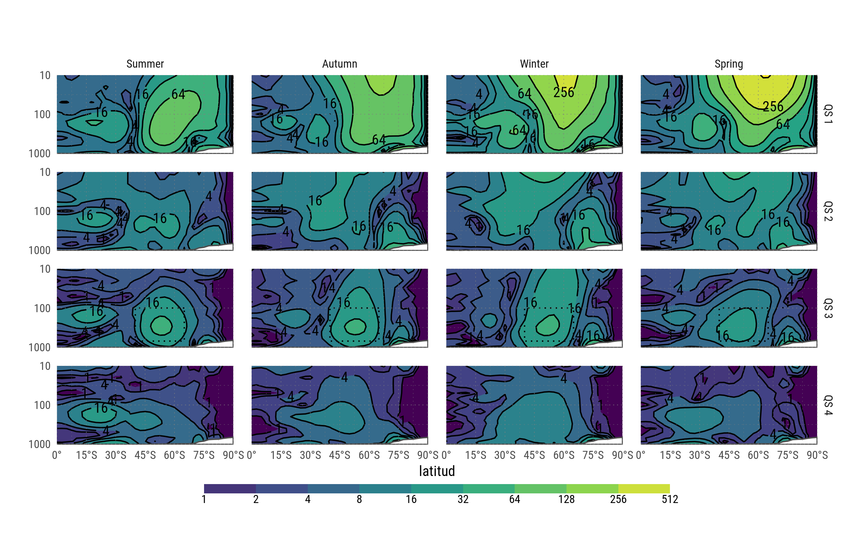
Fourier amplitude of geopotential height

Slide 2
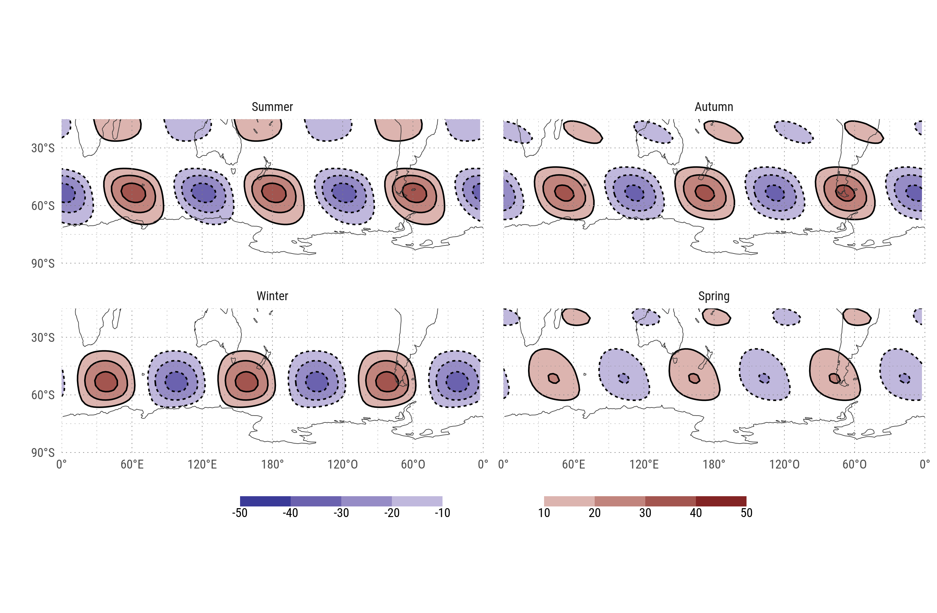
Wave 3 component of the geopotential field of each season at 200hPa.

Slide 3
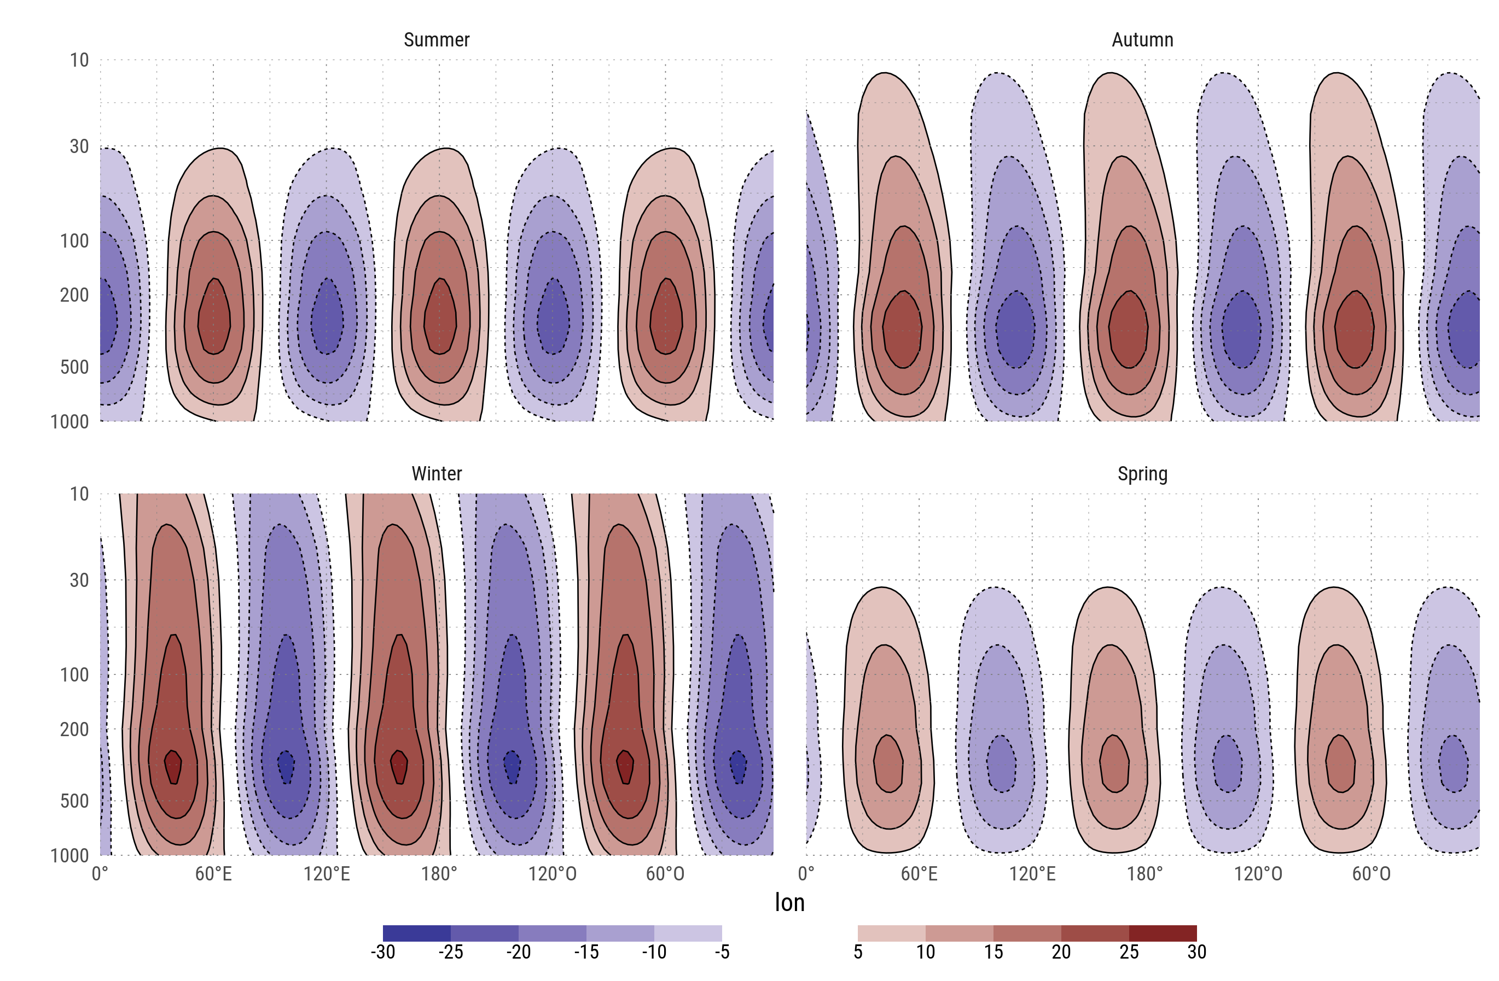
Mean wave 3 component of geopotential height between 65°S and 35°S

Slide 4
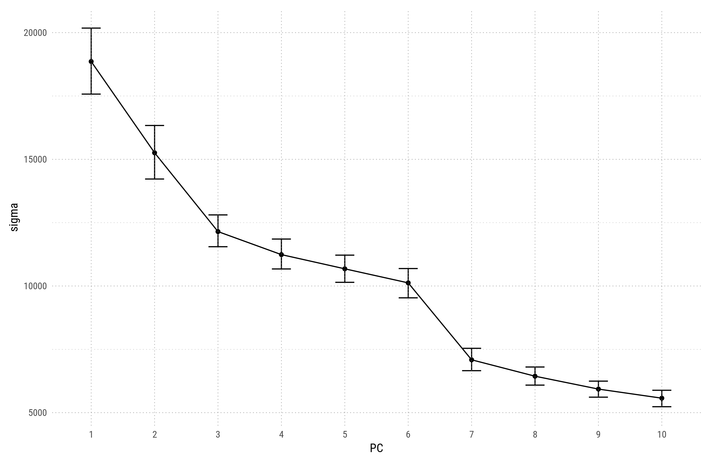
First 4 EOFs derived from the 200hPa detrended geopotential zonal anomaly field between 30°S and 80°S with zonal wave 1 filtered out. Erros bars represent the 95% cuantile range estimated via bootstrap.

Slide 5
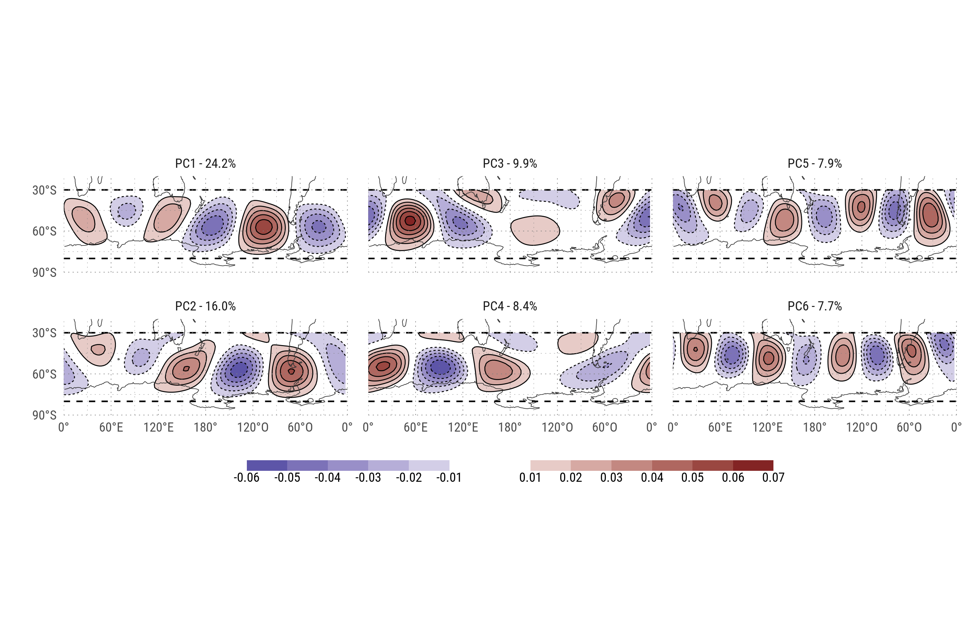
EOFs

Slide 6
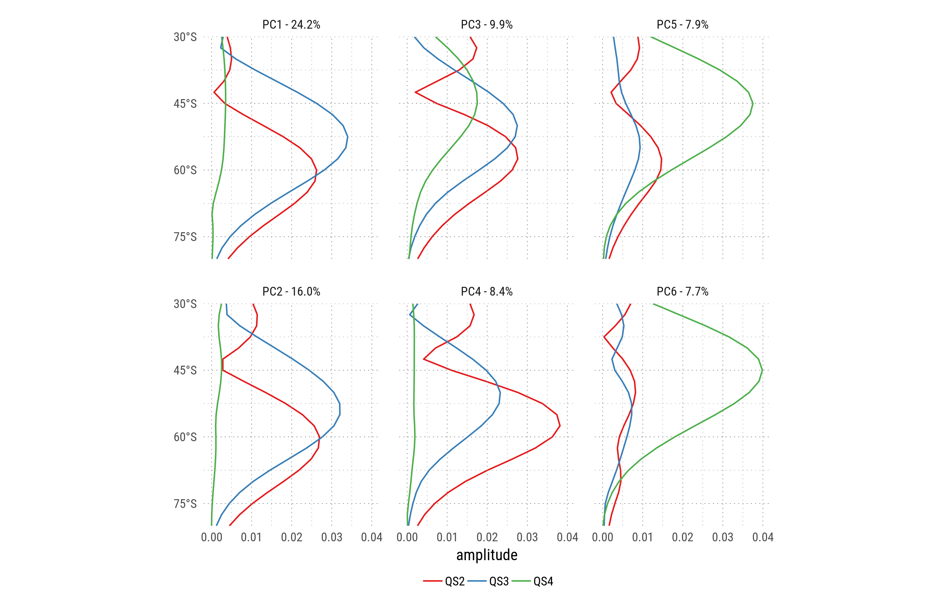
Fourier decomposition by latitude of each EOF.

Slide 7
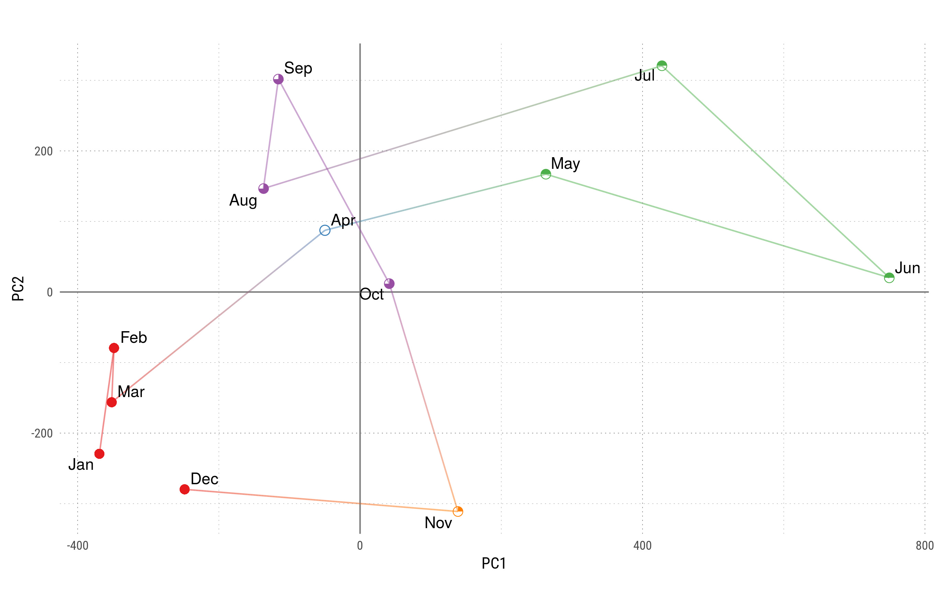
Monthly mean values for each PC. Colors and shapes divide months into 5 'seasons'.

Slide 8
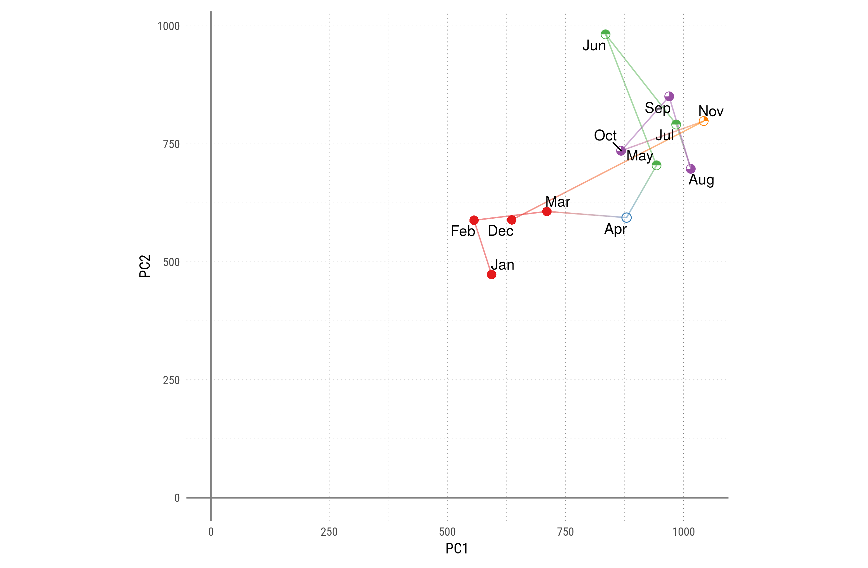
Monthly standard deviation for each PC. Colors and shapes divide months into 5 'seasons'.

Slide 9
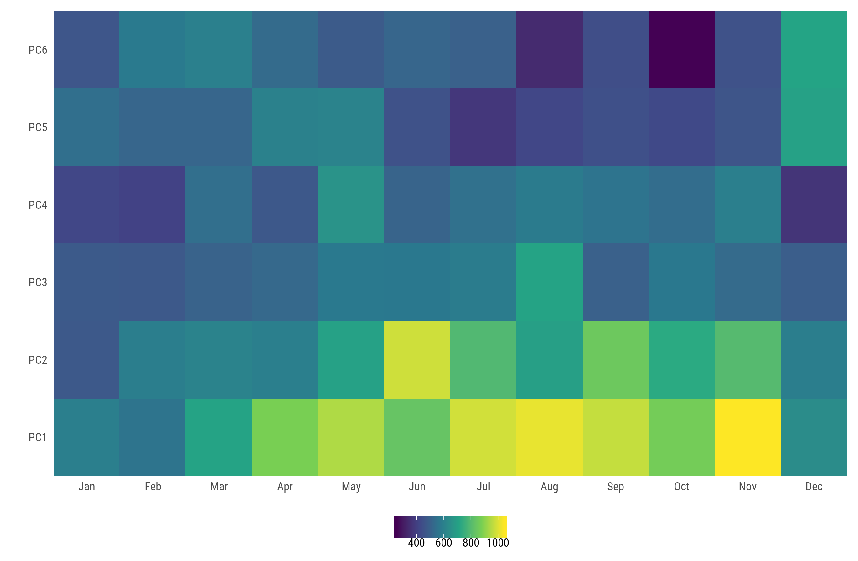
Standard deviation (scaled by their variance) of each PC for each month

Slide 10
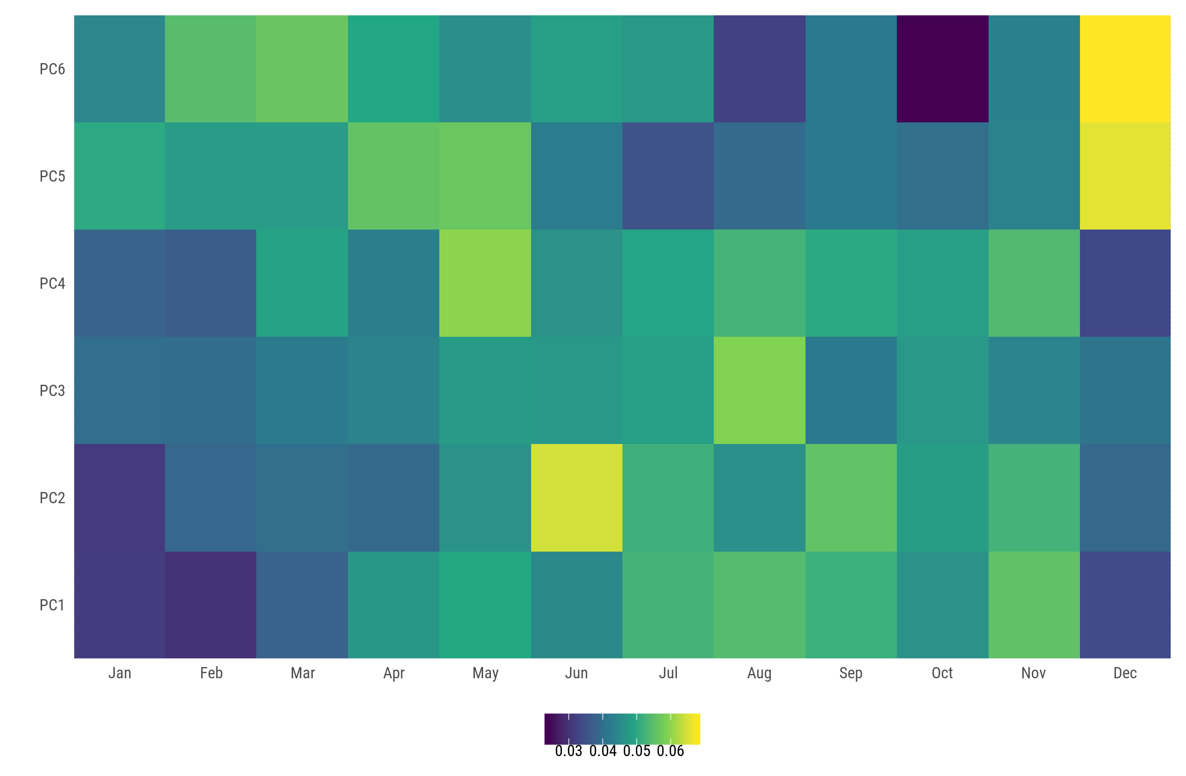
Standard deviation of each PC for each month

Slide 11
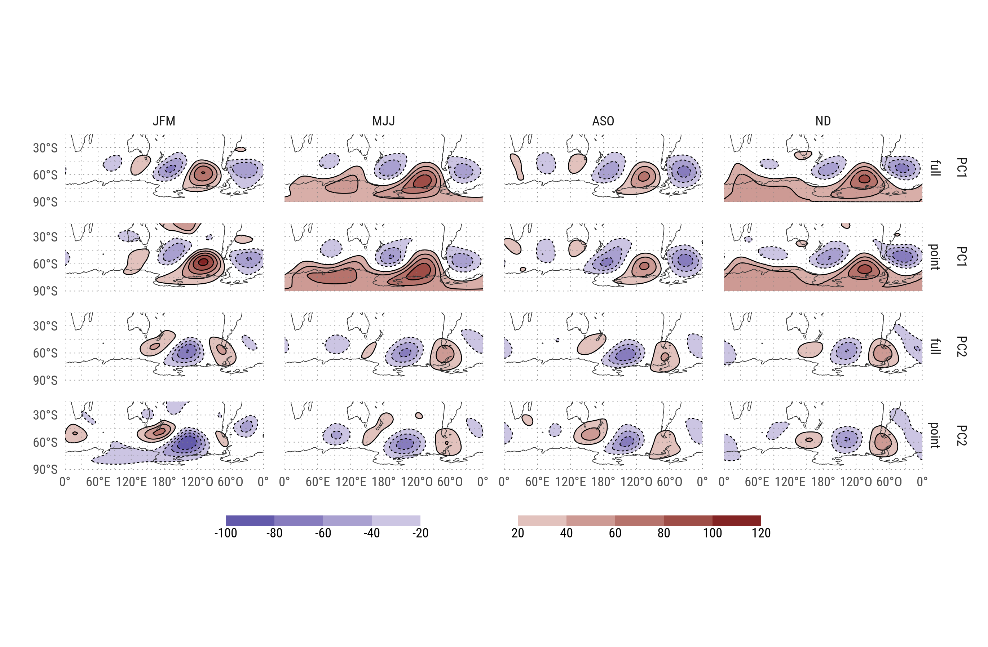
(standarized) Regression between PCs and gh.

Slide 12
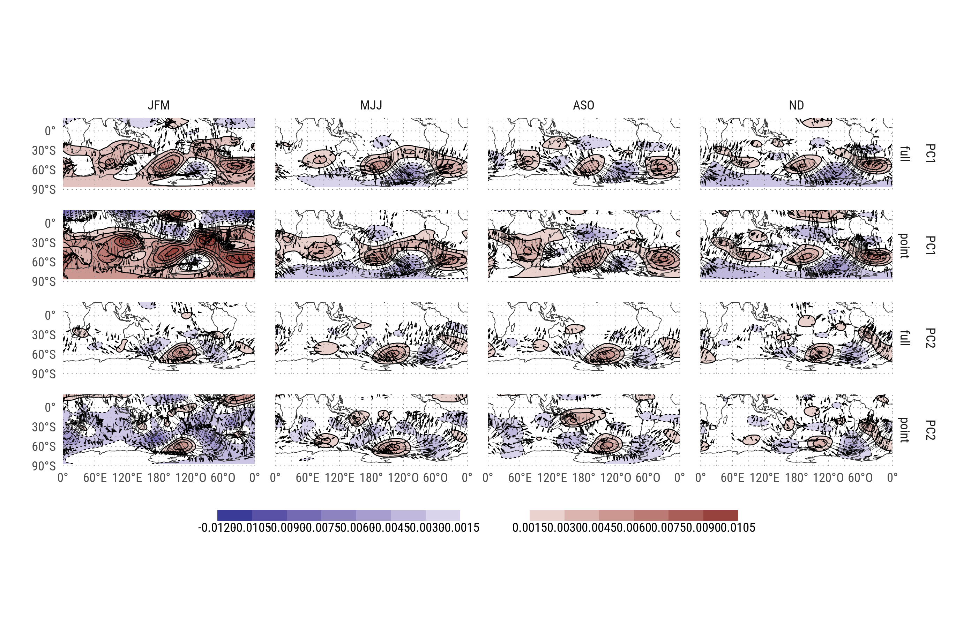
Regression between PCs and Psi.

Slide 13
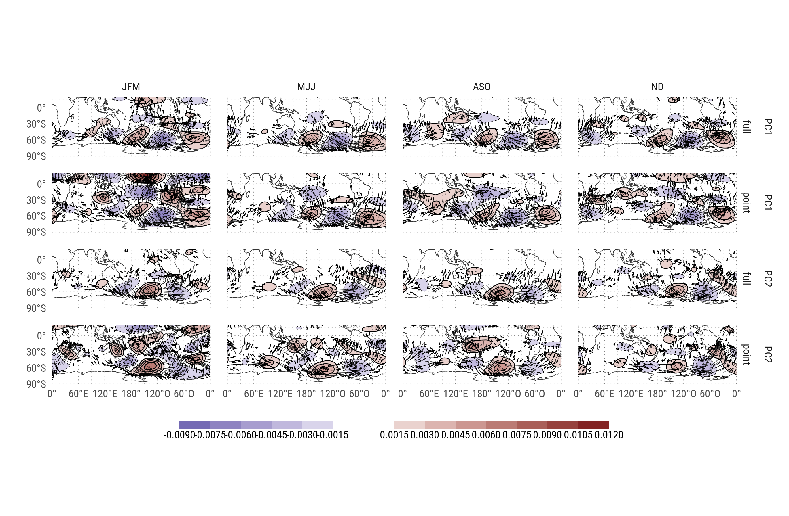
Zonal anomaly of regression between PCs and Psi.

Slide 14
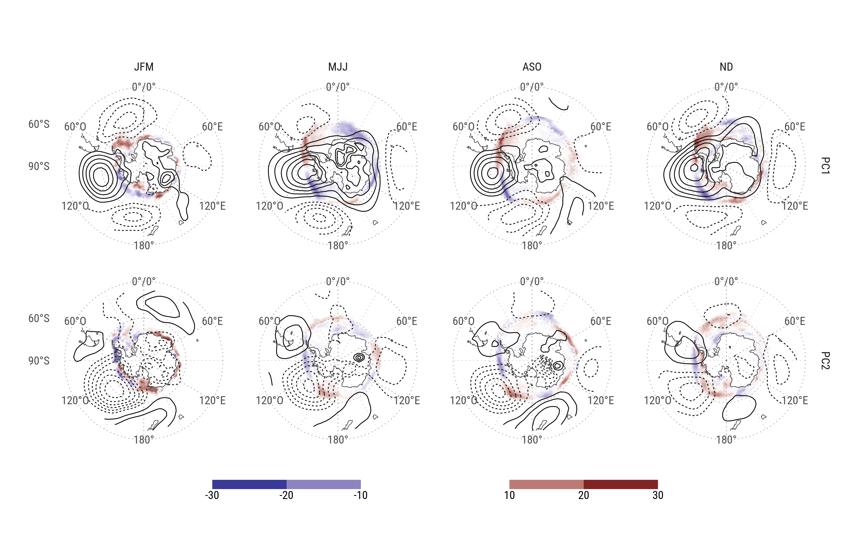
Regression of standarized PC with antarctic sea ice concentrations (shaded) and regression of standarized PC with 200hPa geopotential height (contours).

